Slide 1
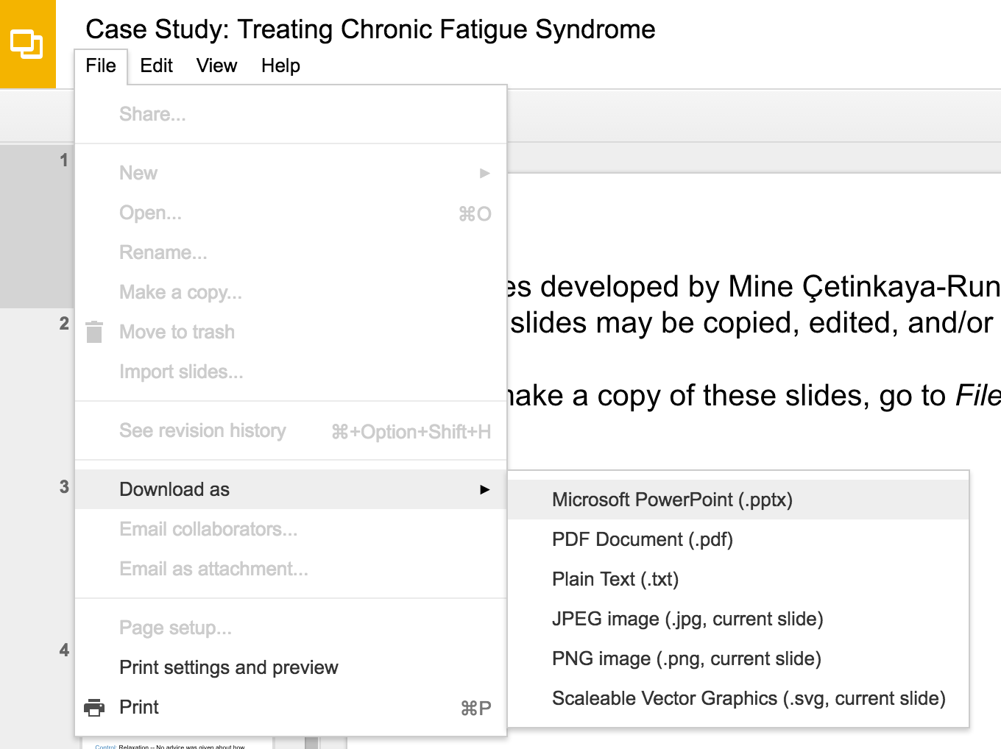
Slides developed by Mine Çetinkaya-Rundel of OpenIntro
Translated from LaTeX to Google Slides by Curry W. Hilton of OpenIntro.
The slides may be copied, edited, and/or shared via the CC BY-SA license
To make a copy of these slides, go to File > Download as > [option], as shown below. Or if you are logged into a Google account, you can choose Make a copy... to create your own version in Google Drive.

Slide 2
Inference for
a Single Proportion

Slide 3
Practice
Two scientists want to know if a certain drug is effective against high blood pressure. The first scientist wants to give the drug to 1000 people with high blood pressure and see how many of them experience lower blood pressure levels. The second scientist wants to give the drug to 500 people with high blood pressure, and not give the drug to another 500 people with high blood pressure, and see how many in both groups experience lower blood pressure levels. Which is the better way to test this drug?
All 1000 get the drug
500 get the drug, 500 don’t

Slide 4
Practice
Two scientists want to know if a certain drug is effective against high blood pressure. The first scientist wants to give the drug to 1000 people with high blood pressure and see how many of them experience lower blood pressure levels. The second scientist wants to give the drug to 500 people with high blood pressure, and not give the drug to another 500 people with high blood pressure, and see how many in both groups experience lower blood pressure levels. Which is the better way to test this drug?
All 1000 get the drug
500 get the drug, 500 don’t

Slide 5
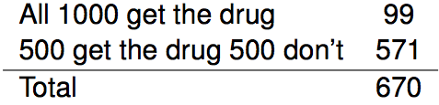
Results from the GSS
The GSS asks the same question, below is the distribution of responses from the 2010 survey:

Slide 6
Parameter and point estimate
We would like to estimate the proportion of all Americans who have good intuition about experimental design, i.e. would answer “500 get the drug 500 don't”? What are the parameter of interest and the point estimate?

Slide 7
Parameter and point estimate
We would like to estimate the proportion of all Americans who have good intuition about experimental design, i.e. would answer “500 get the drug 500 don't”? What are the parameter of interest and the point estimate?
Parameter of interest: proportion of all Americans who have good intuition about experimental design.
p a population proportion

Slide 8
Parameter and point estimate
We would like to estimate the proportion of all Americans who have good intuition about experimental design, i.e. would answer “500 get the drug 500 don't”? What are the parameter of interest and the point estimate?
Parameter of interest: proportion of all Americans who have good intuition about experimental design.
p a population proportion
Point estimate: proportion of sampled Americans who have good intuition about experimental design.
p̂ a sample proportion

Slide 9
Inference on a proportion
What percent of all Americans have good intuition about experimental design, i.e. would answer "500 get the drug 500 don't"?

Slide 10
Inference on a proportion
What percent of all Americans have good intuition about experimental design, i.e. would answer "500 get the drug 500 don't"?
We can answer this research question using a confidence interval, which we know is always of the form
point estimate ± ME

Slide 11
Inference on a proportion
What percent of all Americans have good intuition about experimental design, i.e. would answer "500 get the drug 500 don't"?
We can answer this research question using a confidence interval, which we know is always of the form
point estimate ± ME
And we also know that ME = critical value times the SE of the point estimate.
SE_{p̂} = ?

Slide 12

Inference on a proportion
What percent of all Americans have good intuition about experimental design, i.e. would answer "500 get the drug 500 don't"?
We can answer this research question using a confidence interval, which we know is always of the form
point estimate ± ME
And we also know that ME = critical value times the SE of the point estimate.
SE_{p̂} = ?
Standard error of a sample proportion

Slide 13

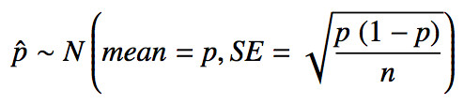
Sample proportions are also nearly normally distributed
Central limit theorem for proportions
Sample proportions will be nearly normally distributed with mean equal to the population mean, p, and standard error equal to
But of course this is true only under certain conditions… any guesses?

Slide 14
Sample proportions are also nearly normally distributed
Central limit theorem for proportions
Sample proportions will be nearly normally distributed with mean equal to the population mean, p, and standard error equal to
But of course this is true only under certain conditions… any guesses?
independent observations, at least 10 successes and 10 failures

Slide 15
Sample proportions are also nearly normally distributed
Central limit theorem for proportions
Sample proportions will be nearly normally distributed with mean equal to the population mean, p, and standard error equal to
But of course this is true only under certain conditions… any guesses?
independent observations, at least 10 successes and 10 failures
_________
Note: If p is unknown (most cases), we use p̂ in the calculation of the standard error.

Slide 16
Back to experimental design...
The GSS found that 571 out of 670 (85%) of Americans answered the question on experimental design correctly. Estimate (using a 95% confidence interval) the proportion of all Americans who have good intuition about experimental design?

Slide 17
Back to experimental design...
The GSS found that 571 out of 670 (85%) of Americans answered the question on experimental design correctly. Estimate (using a 95% confidence interval) the proportion of all Americans who have good intuition about experimental design?
Given: n = 670, p̂ = 0.85. First check conditions.

Slide 18
Back to experimental design...
The GSS found that 571 out of 670 (85%) of Americans answered the question on experimental design correctly. Estimate (using a 95% confidence interval) the proportion of all Americans who have good intuition about experimental design?
Given: n = 670, p̂ = 0.85. First check conditions.
Independence: The sample is random, and 670 < 10% of all Americans, therefore we can assume that one respondent's response is independent of another.

Slide 19
Back to experimental design...
The GSS found that 571 out of 670 (85%) of Americans answered the question on experimental design correctly. Estimate (using a 95% confidence interval) the proportion of all Americans who have good intuition about experimental design?
Given: n = 670, p̂ = 0.85. First check conditions.
Independence: The sample is random, and 670 < 10% of all Americans, therefore we can assume that one respondent's response is independent of another.
Success-failure: 571 people answered correctly (successes) and 99 answered incorrectly (failures), both are greater than 10.

Slide 20
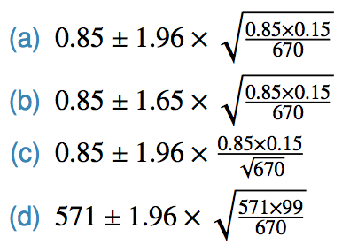
Practice
We are given that n = 670, p̂ = 0.85, we also just learned that the standard error of the sample proportion is
Which of the below is the correct calculation of the 95\% confidence interval?

Slide 21
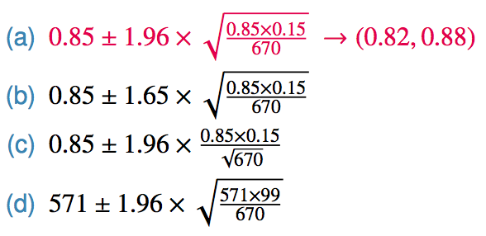
Practice
We are given that n = 670, p̂ = 0.85, we also just learned that the standard error of the sample proportion is
Which of the below is the correct calculation of the 95\% confidence interval?

Slide 22
Choosing a sample size
How many people should you sample in order to cut the margin of error of a 95% confidence interval down to 1%.

Slide 23

Choosing a sample size
How many people should you sample in order to cut the margin of error of a 95% confidence interval down to 1%.

Slide 24
Choosing a sample size
How many people should you sample in order to cut the margin of error of a 95% confidence interval down to 1%.

Slide 25

Choosing a sample size
How many people should you sample in order to cut the margin of error of a 95% confidence interval down to 1%.

Slide 26

Choosing a sample size
How many people should you sample in order to cut the margin of error of a 95% confidence interval down to 1%.

Slide 27
Choosing a sample size
How many people should you sample in order to cut the margin of error of a 95% confidence interval down to 1%.

Slide 28
What if there isn't a previous study?
... use p̂ = 0.5 why?

Slide 29
What if there isn't a previous study?
... use p̂ = 0.5 why?
if you don't know any better, 50-50 is a good guess

Slide 30
What if there isn't a previous study?
... use p̂ = 0.5 why?
if you don't know any better, 50-50 is a good guess
p̂ = 0.5 gives the most conservative estimate -- highest possible sample size

Slide 31


CI vs. HT for proportions
Success-failure condition:
CI: At least 10 observed successes and failures
HT: At least 10 expected successes and failures, calculated using the null value
Standard error:
CI: calculate using observed sample proportion:
HT: calculate using the null value:

Slide 32
Practice
The GSS found that 571 out of 670 (85%) of Americans answered the question on experimental design correctly. Do these data provide convincing evidence that more than 80% of Americans have a good intuition about experimental design?

Slide 33
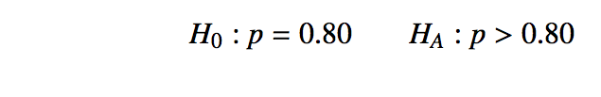
Practice
The GSS found that 571 out of 670 (85%) of Americans answered the question on experimental design correctly. Do these data provide convincing evidence that more than 80% of Americans have a good intuition about experimental design?

Slide 34

Practice
The GSS found that 571 out of 670 (85%) of Americans answered the question on experimental design correctly. Do these data provide convincing evidence that more than 80% of Americans have a good intuition about experimental design?

Slide 35

Practice
The GSS found that 571 out of 670 (85%) of Americans answered the question on experimental design correctly. Do these data provide convincing evidence that more than 80% of Americans have a good intuition about experimental design?

Slide 36
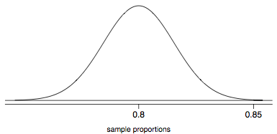

Practice
The GSS found that 571 out of 670 (85%) of Americans answered the question on experimental design correctly. Do these data provide convincing evidence that more than 80% of Americans have a good intuition about experimental design?

Slide 37
Practice
The GSS found that 571 out of 670 (85%) of Americans answered the question on experimental design correctly. Do these data provide convincing evidence that more than 80% of Americans have a good intuition about experimental design?
Since the p-value is low, we reject H₀. The data provide convincing evidence that more than 80% of Americans have a good intuition on experimental design.

Slide 38
Practice
11% of 1,001 Americans responding to a 2006 Gallup survey stated that they have objections to celebrating Halloween on religious grounds. At 95% confidence level, the margin of error for this survey is ±3%. A news piece on this study's findings states: "More than 10% of all Americans have objections on religious grounds to celebrating Halloween." At 95% confidence level, is this news piece's statement justified?
Yes
No
Can’t tell

Slide 39
Practice
11% of 1,001 Americans responding to a 2006 Gallup survey stated that they have objections to celebrating Halloween on religious grounds. At 95% confidence level, the margin of error for this survey is ±3%. A news piece on this study's findings states: "More than 10% of all Americans have objections on religious grounds to celebrating Halloween." At 95% confidence level, is this news piece's statement justified?
Yes
No
Can’t tell

Slide 40
Recap - inference for one proportion
Population parameter: p, point estimate: p̂

Slide 41
Recap - inference for one proportion
Population parameter: p, point estimate: p̂
Conditions
independence - random sample and 10% condition
at least 10 successes and failures - if not → randomization

Slide 42

Recap - inference for one proportion
Population parameter: p, point estimate: p̂
Conditions
independence - random sample and 10% condition
at least 10 successes and failures - if not → randomization
Standard error:
for CI: use p̂
for HT: use p₀

Slide 43
Find more resources at openintro.org/os, including
Slides
Videos
Statistical Software Labs
Discussion Forums (free support for students and teachers)
Learning Objectives
Teachers only content is also available for Verified Teachers, including
Exercise solutions
Sample exams
Ability to request a free desk copy for a course
Statistics Teachers email group
Questions? Contact us.

